Slide 1

Customer Acquisition Analytics
Group BFS5:
Aryama Ray
Anand Naik
Chetankumar Trivedi

Slide 2
Problem Statement & Objective
Problem Statement:
Company receives thousands of applications every year for new credit cards
In the past few years, it has experienced an increase in credit loss due to bad customers acquired
Objective:
Identify right customers to grant credit card using predictive model using applicant’s historical information so that:
  Credit Loss is minimised
  Decision on credit card approval / rejection is taken more objectively based on scientific scoring criteria

Slide 3
Deliverables
Develop a predictive model :
To determine factors affective credit risk
Create strategies to mitigate acquisition risk – avoid potential credit loss
Identify the cut-off score for auto approval / rejection of applicant – Application Score Card Approach
Arrive at a financial benefit of using such model based approach – Assumptions, Robustness and Pros/Cons of using the model

Slide 4
Approach
Data Preparation
  Data Sourcing – Acquire Historical Demographic and Credit Bureau information
  Data Cleaning – Treatment for outliers, missing values, duplicity check etc. to sanitise data
Data Understanding
  Exploratory Data Analysis
  User of WoE and IV Analysis to identify strong predictors
Data Modelling – Use different modelling techniques
Model Selection and Evaluation
  Select the best model based on criteria
  Evaluate chosen model based on discriminative powers
Financial Benefits Analysis
  Prepare Application Score Card and Derive Cut-off Score for Applicant’s Approval
  Financial Justification of Model

Slide 5
Data Preparation
Key Considerations / Assumptions
Total # of Records – 71295 in each data set, demographic and credit bureau data sets.
Both data sets are merged based on unique applicant ID. Merged data is taken for further analysis and modelling.
Performance Tag “1” is taken as default case and “0” as non-default case
Removal of Duplicate Records – 3 in each data set. All 3 were same in both data sets.
There are 1425 records without any value of Performance Tag. They are separated out as rejection population.
There are 1026 records having NA values. They are removed for further analysis and modelling.
There are 145 records having blank values for categorical variable. They are removed for further analysis.
Negative Values for Age and Income are removed.
Outlier treatment is not carried out manually as WoE transformation would take care of this aspect.
Few continuous variables are factorized and / or binned as appropriate for logical grouping.
WoE Transformation has been carried out. Based on this variables having strong predictive power are filtered and values are replaced.
70:30 ratio has been considered for train / test data split.

Slide 6
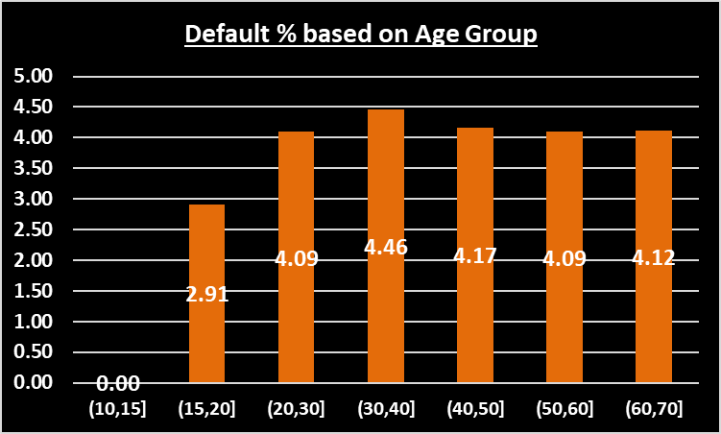
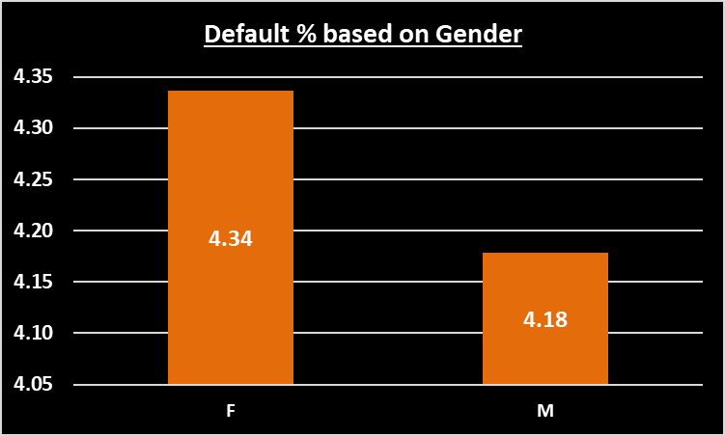
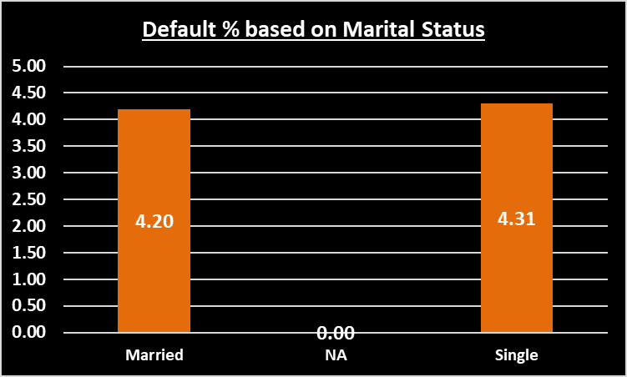
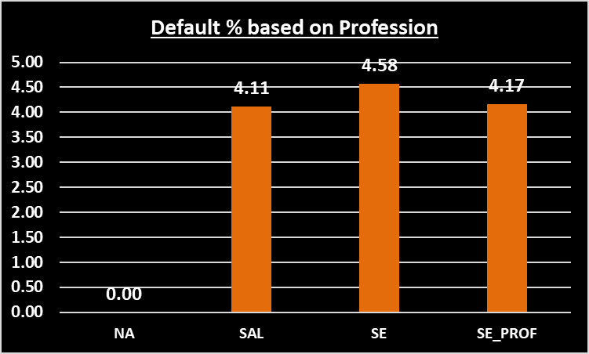
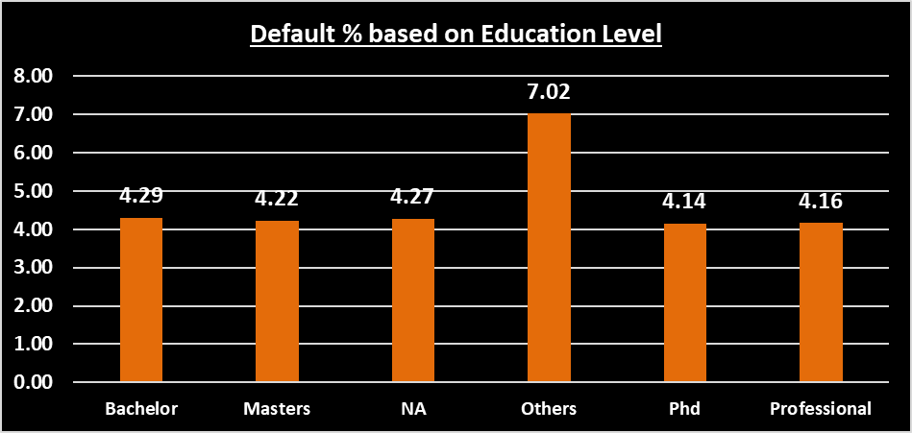
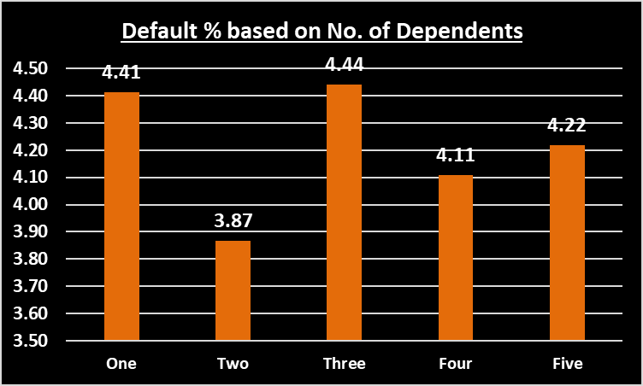
Exploratory Analysis – Demographic Data
There is no significant variation in default % over various levels of above parameters. Hence they don’t carry any material impact on deciding default of an applicant.

Slide 7
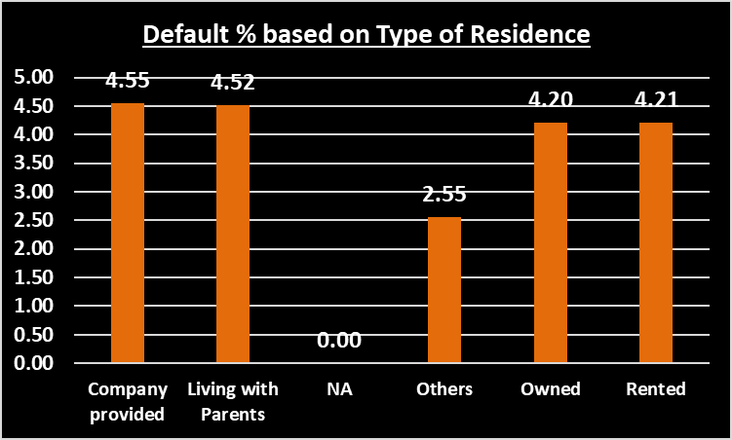
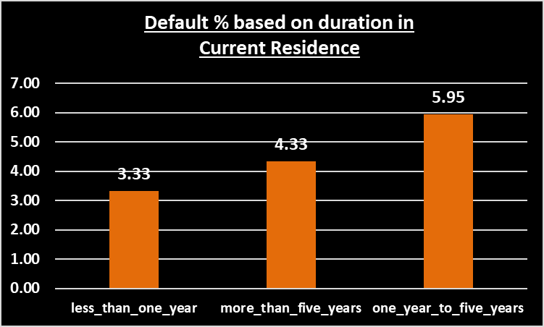
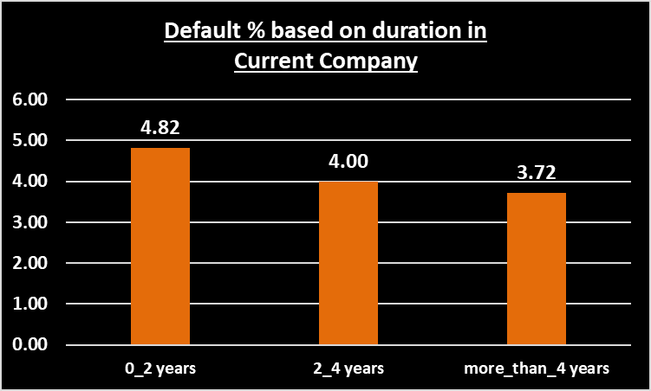
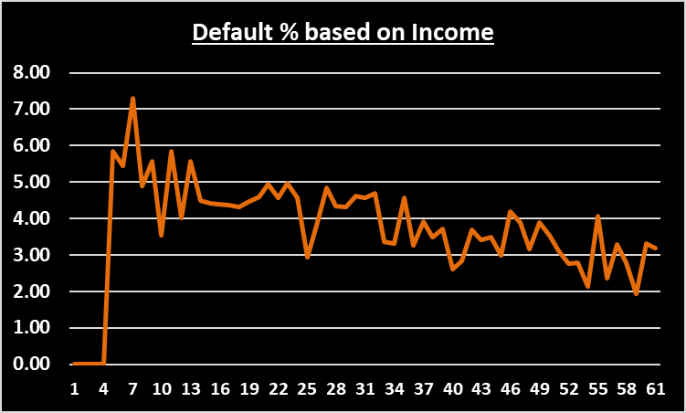
Exploratory Analysis – Demographic Data (Contd..)
Default % varies based on type of residence
Default % increases with duration in the same residence
Default % decreases with increase of duration in the same company
Default % decreases with increase in income level

Slide 8
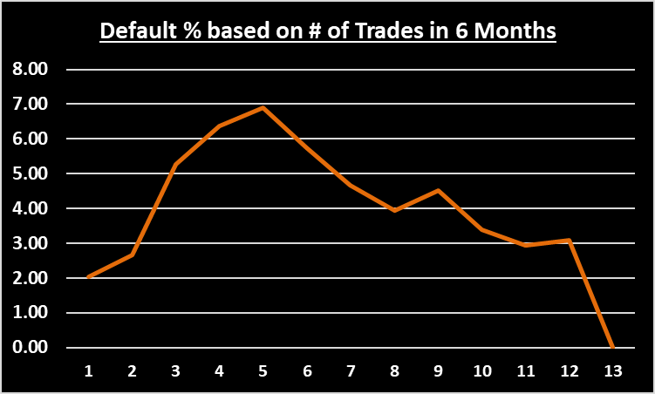
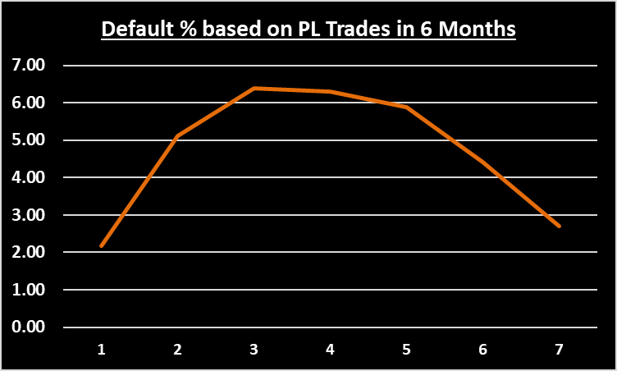
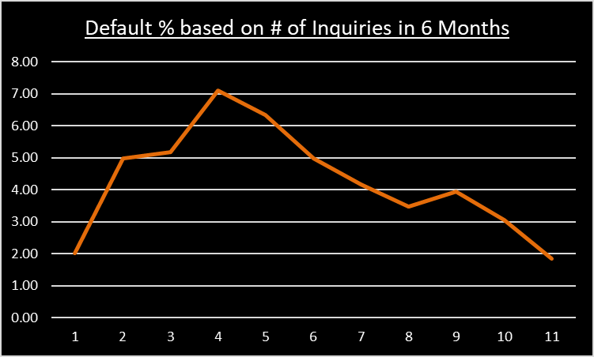
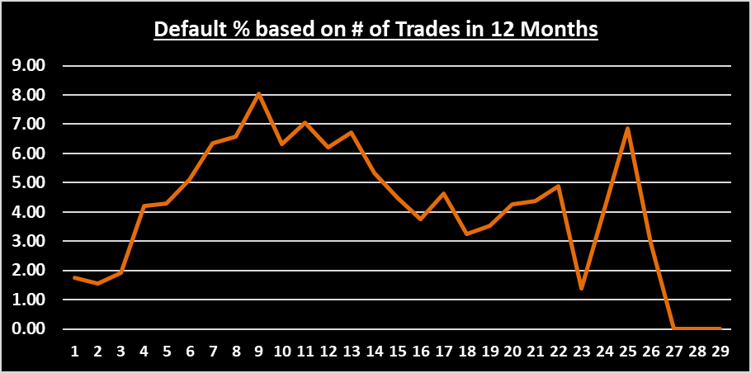
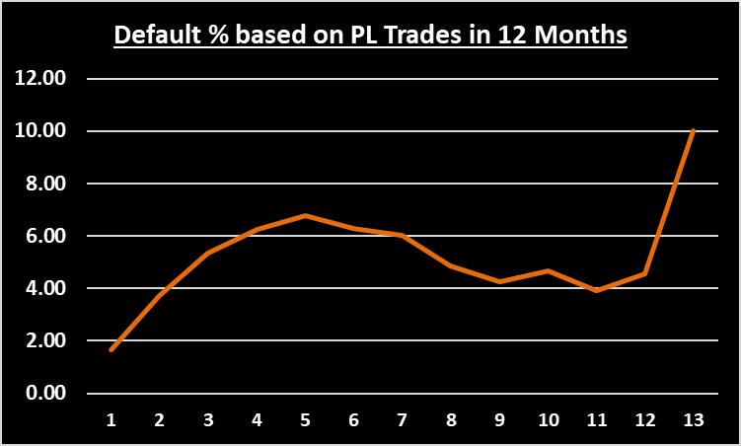
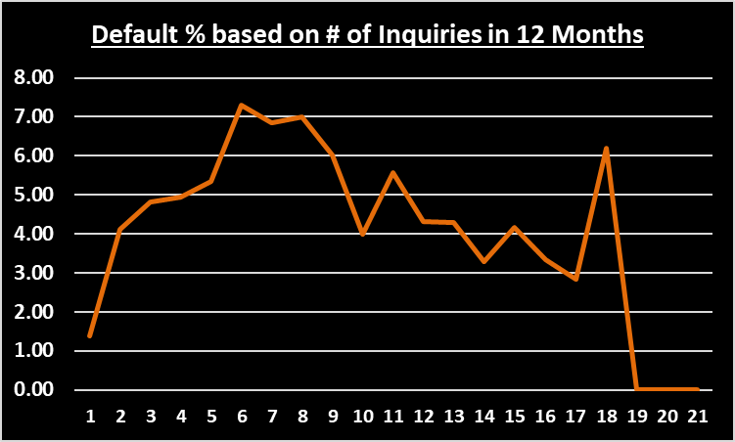
Exploratory Analysis – Credit History Data
Default % rate varies significantly for # of Trades, # PL Trades and # of Inquiries. So it does have significance. However, there is no clear trend visible. Shall get verified in modelling.

Slide 9
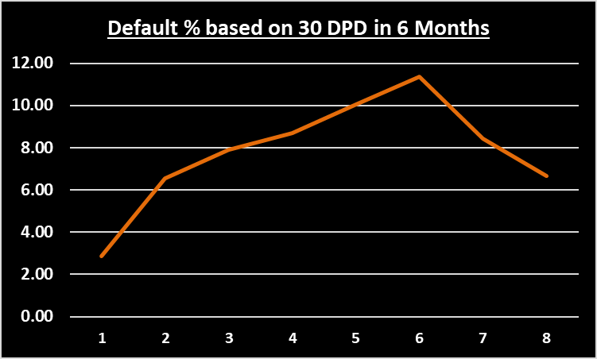
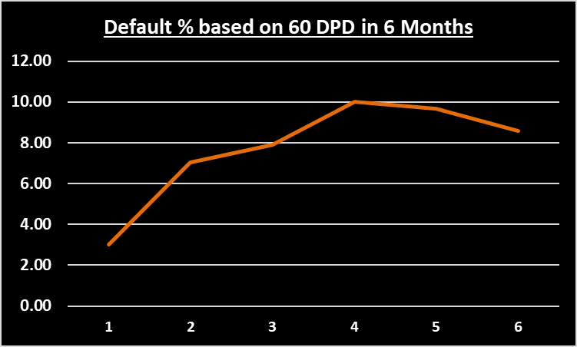
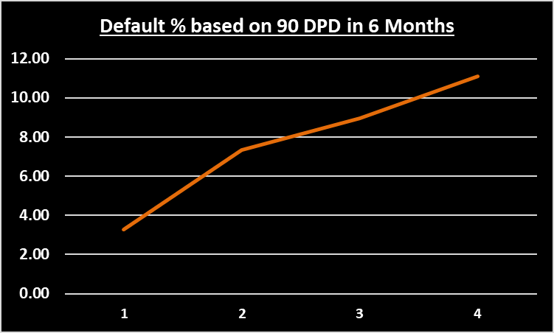
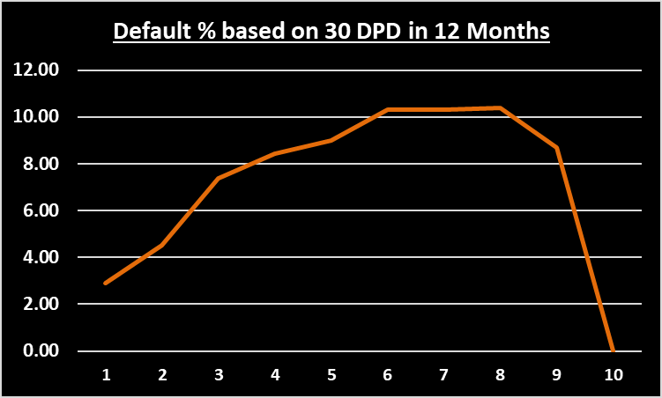
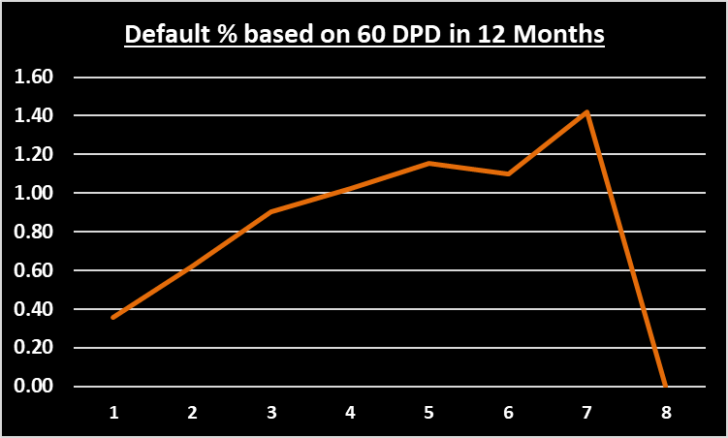
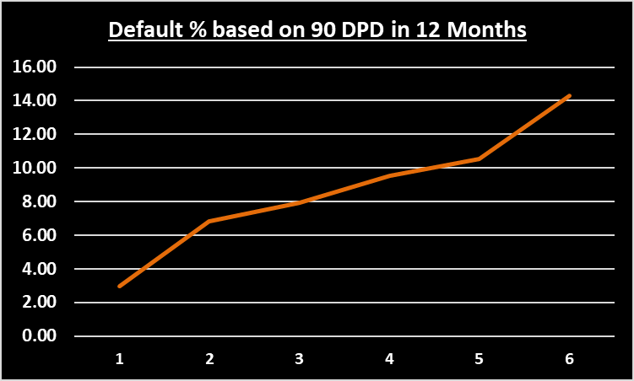
Exploratory Analysis – Credit History Data (Contd..)
Default % rate increases clearly with 30 DPD, 60 DPD and 90 DPD for 6 and 12 months respectively. These seem to be strong predictors.

Slide 10
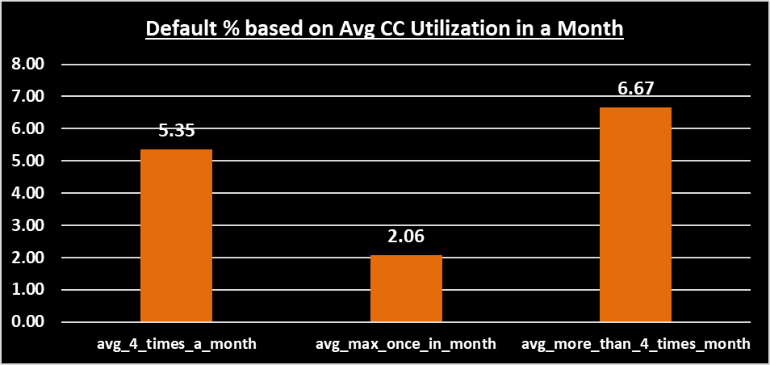
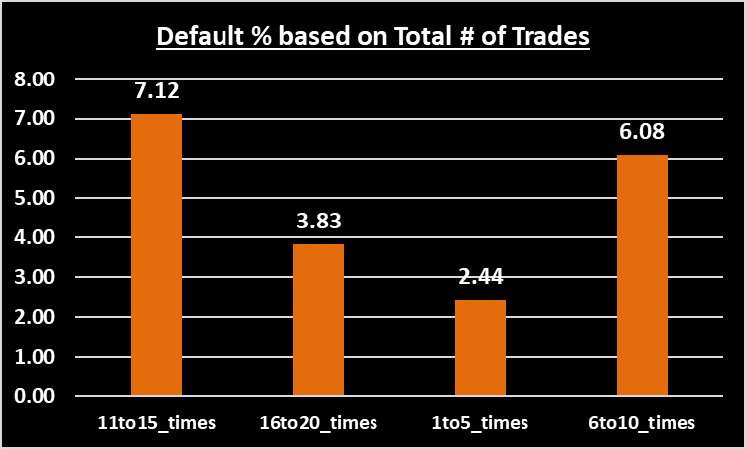
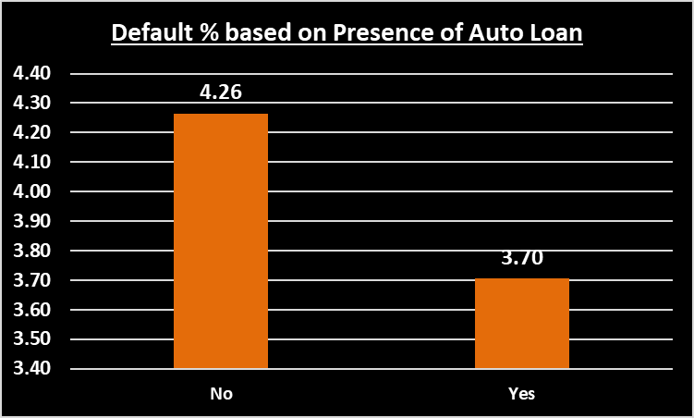
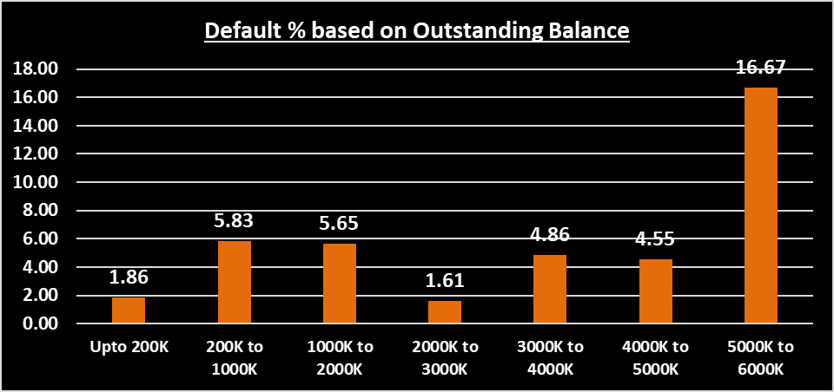
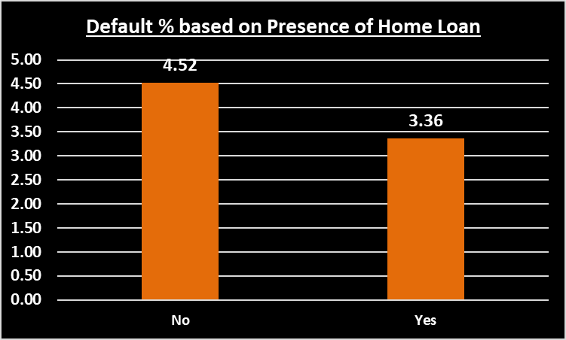
Exploratory Analysis – Credit History Data (Contd..)
Default % clearly increases with increase in average CC utilization in last 12 months. It’s seems a strong predictor.
Default % varies with total number of trades. However, it does not give any clear trend.
Default % is more for applicants not having any home loan or auto loan. It’s bit counter-intuitive. Though population having loan is also very low.
Default % varies with outstanding balance. It seems to be a strong predictive indicator.

Slide 11
Exploratory Data Analysis - Summary
No Predictive Power
Age
Gender
Marital Status
Education
Profession
No. of Dependents
Low / Medium Predictive Power
Type of Residence
PL Trades in 6 Months
PL Trades in 12 Months
No.of Trades in 6 Months
No.of Trades in 12 Months
Inquiries in 6 Months
Inquiries in 12 Months
Presence of Auto Loan
Presence of Home Loan
Strong Predictive Power
Income
Duration in same residence
Duration in same company
30 DPD in last 6 Months
30 DPD in last 12 Months
60 DPD in last 6 Months
60 DPD in last 12 Months
90 DPD in last 6 Months
90 DPD in last 12 Months
Avg CC Utilization in 12 Months
Total No. of Trades
Outstanding Balance
** During WoE / IV Analysis and Modelling, this initial understanding would be validated.

Slide 12
Exploratory Data Analysis – Correlation Matrix
Number of times customer has not payed dues since 90/60/30 days in last 6/12 months are highly correlated with each other.
Presence of home loan and outstanding balance are highly correlated.
Total number of trades is highly correlated with number of trades/PL trades opened in last 6/12 months. It has also high correlation with number of queries made in last 6/12 months excluding home/auto loans.

Slide 13
Data Modelling
Following data modelling have been performed.
On Demographic Data Only
  Logistic Regression
On Merged Data Set (Demographic + Credit Bureau along with WoE Transformation)
  Biased Data Set – Logistic Regression
  Biased Data Set – Random Forest
  Unbiased Data Set (SMOTE) – Logistic Regression
  Unbiased Data Set (SMOTE) – Random Forest without Cross Validation
  Unbiased Data Set (SMOTE) – Random Forest with Cross Validation

Slide 14
Model Outcome and Selection (On Demographic Data)
Logistic Regression (Demographic Data Only)
Model has come out with following 3 variables as predicting ones:
Income
No. of months in current residence – < 1 year
No. of months in current residence – 1 to 5 years
Key Model Statistics are:
Accuracy : 0.5246196 (Moderate)
Sensitivity : 0.5990783 (Moderate)
Specificity : 0.5213398 (Moderate)
KS Statistics : 0.1204181 (Low)
Probability Cut-off : 0.03969697
Conclusion:
This confirms our EDA revelation of demographic variables having strong predictive power.
Model does not have decent statistics on robustness. Hence model on demographic data alone is not enough to predict default at a good level.

Slide 15
Model Outcome and Selection (On Biased Merged Data)
On Merged Data Set – Biased Data Set (Demographic + Credit Bureau with WoE Values)
Model has come out with following 3 variables as predicting ones:
No. of times 30 DPD or worse in last 12 months
Average CC Utilization in last 12 months
No. of inquiries in last 12 months
Key Model Statistics are:
Logistic Regression Random Forest
Accuracy : 0.6342029 (Very Good) : 0.6227053 (Very Good)
Sensitivity : 0.6204955 (Very Good) : 0.6103604 (Vert Good)
Specificity : 0.6348173 (Very Good) : 0.6232586 (Very Good)
KS Statistics : 0.2553128 (Moderate) : 0.2336190 (Moderate)
Probability Cut-off : 0.0450000 : 0.03880000
Conclusion:
Variables in model are in line with our EDA outcome of variables having strong predictive power.
Model has decent statistics on robustness.

Slide 16
Model Outcome and Selection (On Unbiased Merged Data)
On Merged Data Set – Unbiased Data Set (Demographic + Credit Bureau with WoE Values)
Model has come out with following 4 variables as predicting ones:
No. of times 90 DPD or worse in last 12 months
No. of times 30 DPD or worse in last 12 months
No. of PL trades opened in last 12 months
No. of inquiries in last 12 months
Key Model Statistics are:
Logistic Regression Random Forest without CV Random Forest with CV
Accuracy : 0.6794686 (Vert Good) : 0.6307246 (Very Good) : 0.6035749 (Good)
Sensitivity : 0.5540541 (Moderate) : 0.5900901 (Good) : 0.5822072 (Good)
Specificity : 0.6850898 (Ver Good) : 0.6325459 (Very Good) : 0.6045326 (Good)
KS Statistics : 0.2391439 (Moderate) : 0.2226360 (Moderate) : 0.1867398 (Low)
Probability Cut-off : 0.5346465 : 0.36111111 : 0.32919192
Conclusion:
Variables in model are in line with our EDA outcome of variables having strong predictive power.
Models have decent statistics of robustness.

Slide 17
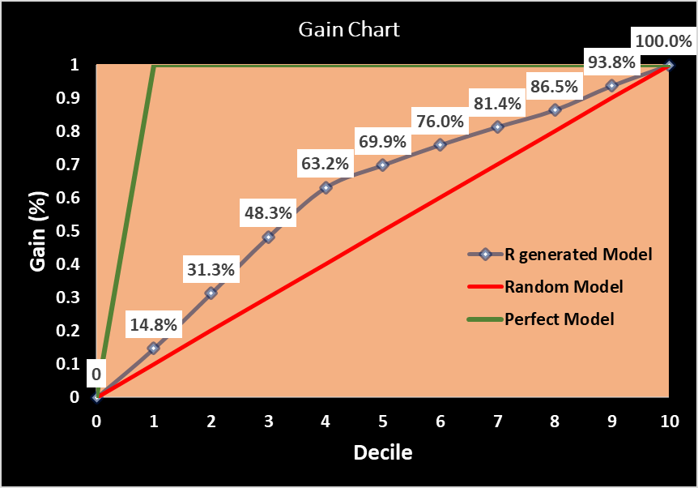
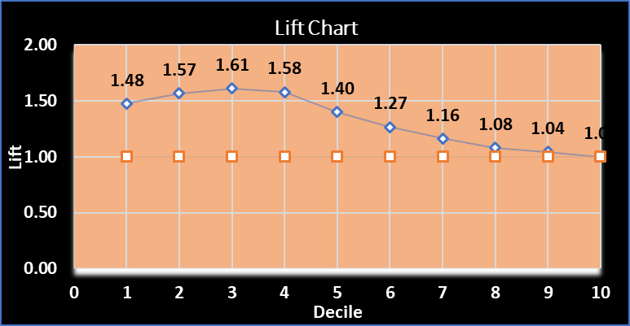
Model Evaluation (Logistic Regression Biased Data)
Model has decent level of Accuracy = 63.42% , Sensitivity = 62.05% and Specificity = 63.48% at optimal cut-off probability of 0.0450000
It has a satisfactory level of Gain and Lift as compared to Random Model.
It has KS Statistics of 24.2% at 4th decile, which is moderate.
Accepted

Slide 18

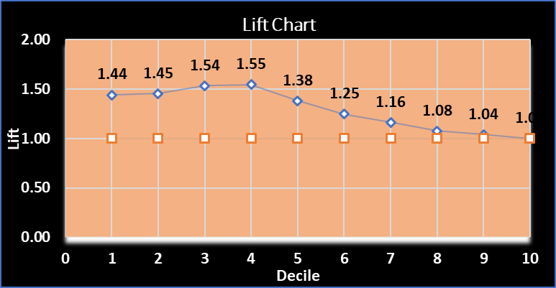
Model Evaluation (Random Forest Biased Data)
Model has decent level of Accuracy = 62.27% , Sensitivity = 61.04% and Specificity = 62.33% at optimal cut-off probability of 0.0450000
It has a satisfactory level of Gain and Lift as compared to Random Model.
It has KS Statistics of 22.8% at 4th decile, which is moderate.
Accepted

Slide 19

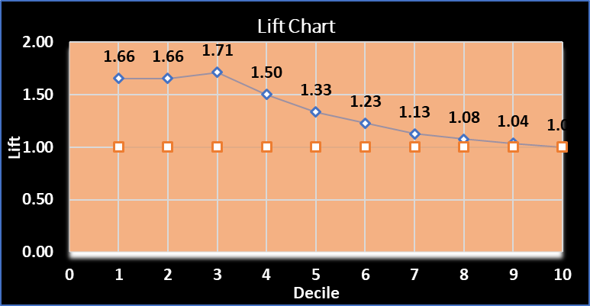
Model Evaluation (Logistic Regression Unbiased Data)
Model has decent level of Accuracy = 67.95% , Sensitivity = 55.41% and Specificity = 68.51% at optimal cut-off probability of 0.5346465
It has a satisfactory level of Gain and Lift as compared to Random Model.
It has KS Statistics of 22.3% at 3rd decile, which is moderate.
Rejected

Slide 20

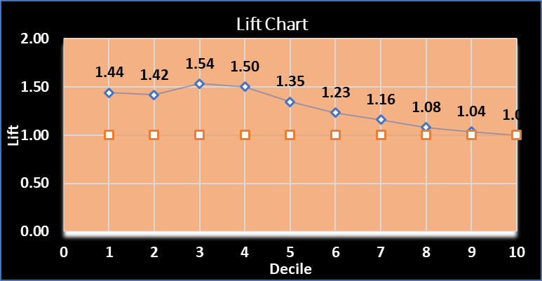
Model Evaluation (Random Forest Unbiased Data without CV)
Model has decent level of Accuracy = 63.07% , Sensitivity = 59.01% and Specificity = 63.25% at optimal cut-off probability of 0.36111111
It has a satisfactory level of Gain and Lift as compared to Random Model.
It has KS Statistics of 21.00% at 4th decile, which is moderate.
Accepted

Slide 21
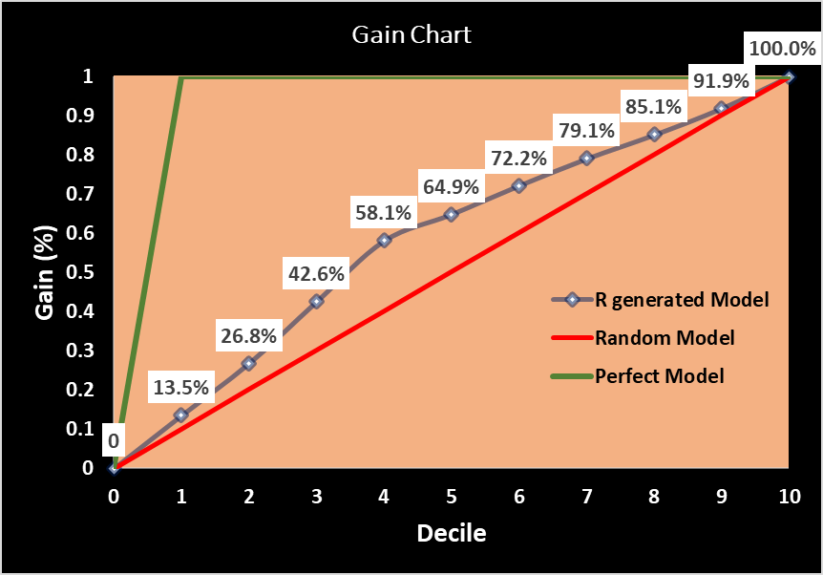
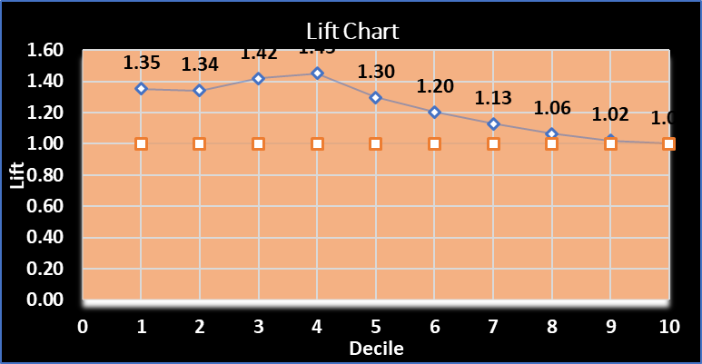
Model Evaluation (Random Forest Unbiased Data with CV)
Model has decent level of Accuracy = 60.36% , Sensitivity = 58.22% and Specificity = 60.45% at optimal cut-off probability of 0.32919192
It has a lower level of Gain and Lift as compared to Random Model.
It has KS Statistics of 18.9% at 4th decile, which is low.
Rejected

Slide 22
Model Selection
Out of total 5 models, 3 are accepted and 2 are rejected based on model statistics
Model built using unbiased data is preferred over model built using biased data
Model built using cross-validation and unbiased data with good statistics is more robust
Considering the above points, Random Forest with CV on Unbiased Data is chosen as the final model

Slide 23
Financial Benefits Analysis of Model
350.0239
Cut off Score for automatic approval or rejection of applicant by this model
~59%
Of total Defaulted Applicants would have been avoided by applying this model
~216 mio
Amount could have been saved on account of credit loss by applying this model
~36.75%
Of good customers (non-default) would have been rejected by applying this model (Revenue Loss)

Slide 24
Thank You

